Slide 1


The Freedom Samsung.... for your Freedom
Freedom Samsung offers ONEOFFICE solution for all your office needs.
Oneoffice package deals come in bundles….All for 5 year contract.
Each Bundle package includes Free Minutes on every network worth more than installment:
Choose Bundles with free minutes pm that best suits you.We can do analysis on your current phone usage and assist to select the most cost effective bundle.
Freedomsamsung Partner

Slide 2
Freedom samsung
OneOffice Bundles
oneoffice
“technology was invented to make our lives easier
- not our choices”
Adam Jensen
Freedoomsamsung Partner

Slide 3
Intentions
Our intention with oneoffice was to do something
different – bundle the most advanced SAMSUNG HD
PBX & security camera systems into an offer that pays for itself
Freedomsamsung Partner

Slide 4
What each bundle consists of
Full feature IP pbx
Voicemail & auto attendant
24 button reception IP phone
Encrypted voice recording
Standard IP phones
Telephone management reports
4 x HD CCTV cameras + DVR
Freedomsamsung Partner

Slide 5
POE switch
LTE router + firewall
Installation + cabling
5-year remote maintenance plan
Server Cabinet
2 Port analogue switch
UPS
Freedomsamsung Partner

Slide 6
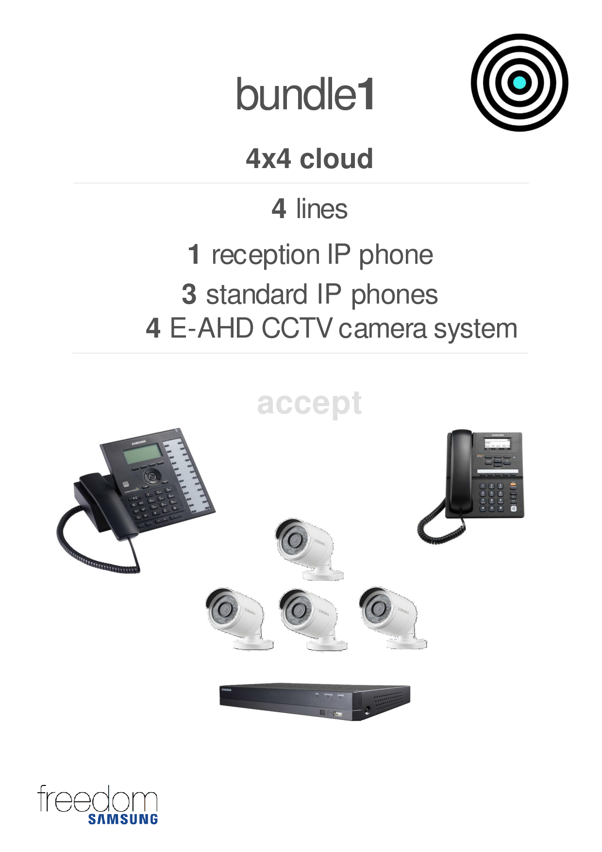
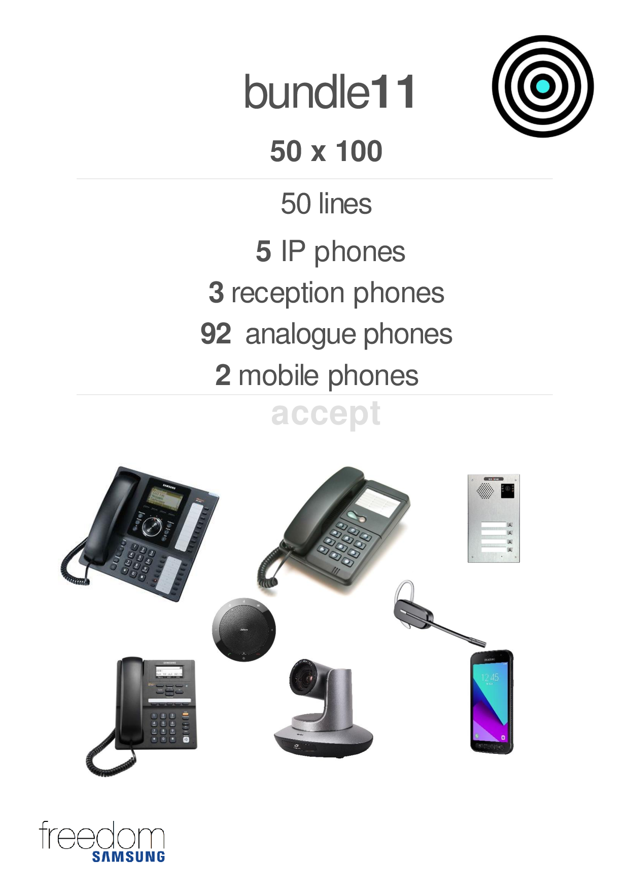
Freedomsamsung Partner

Slide 7
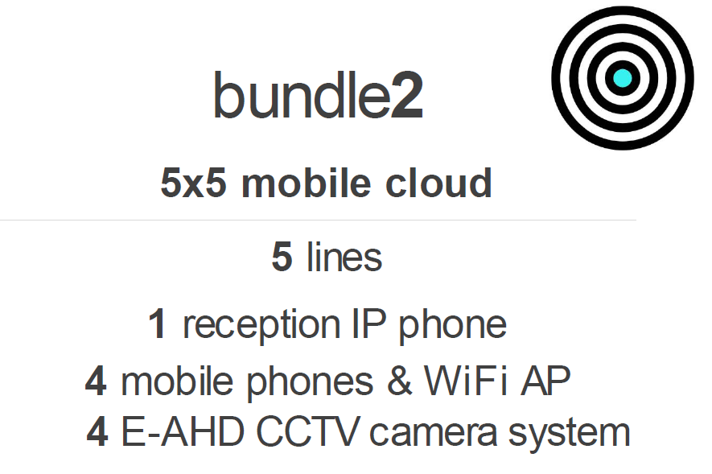
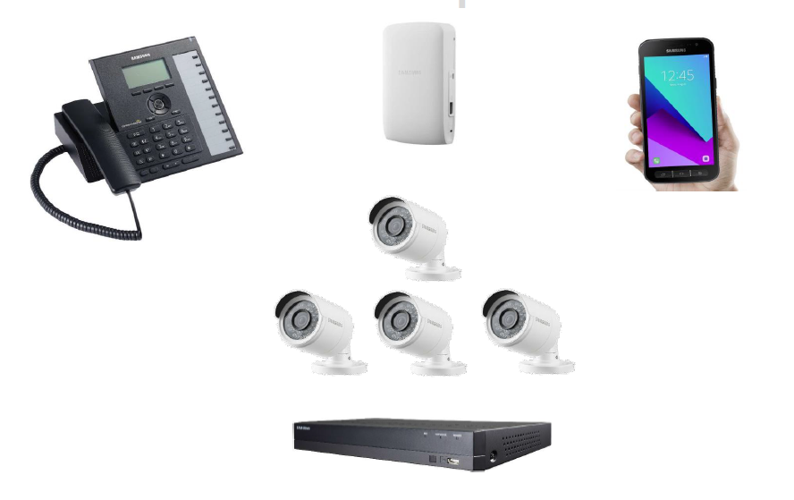
Freedomsamsung Partner

Slide 8
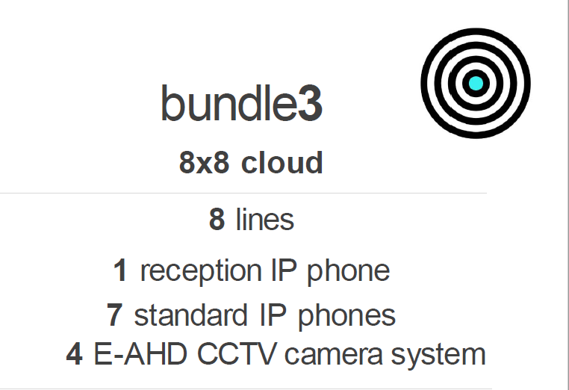
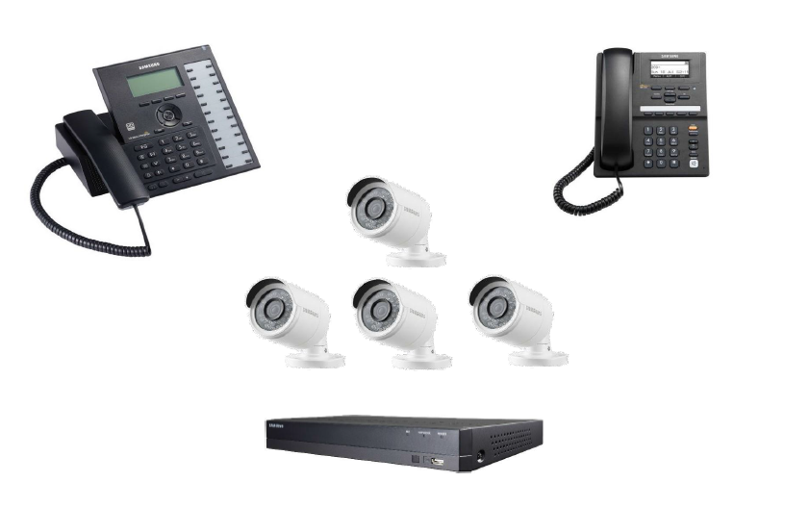
Freedomsamsung Partner

Slide 9
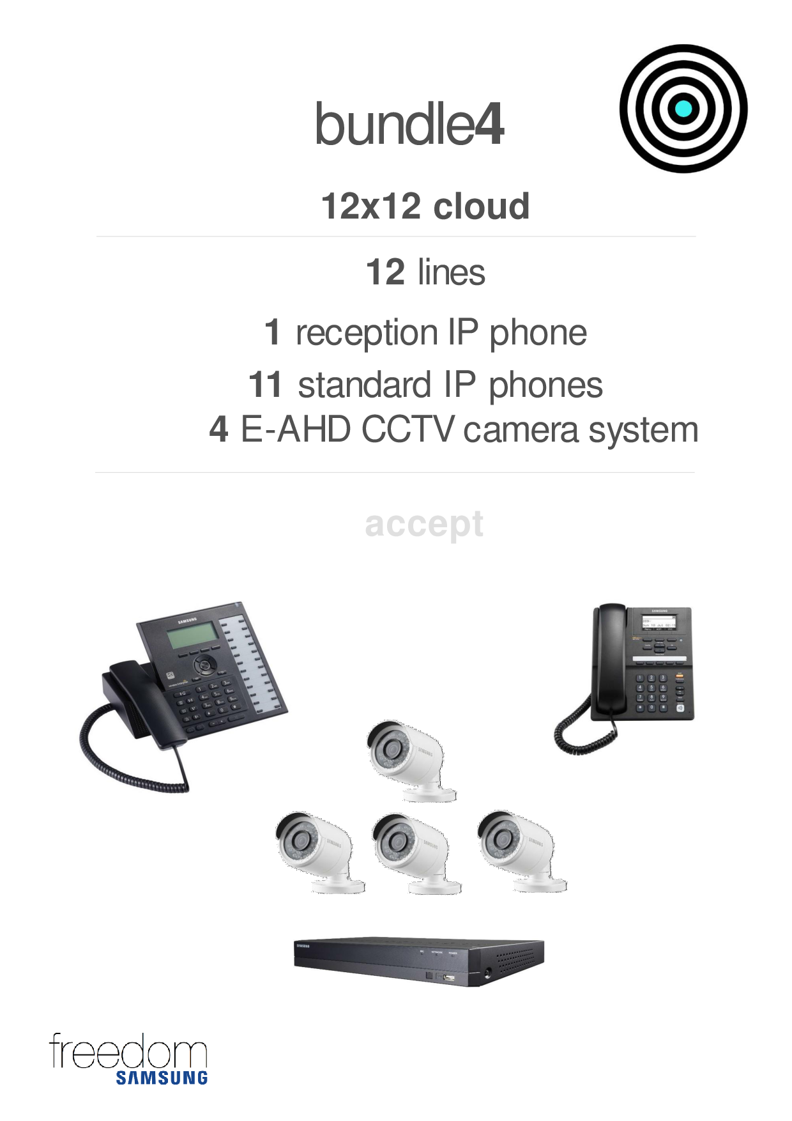
Freedomsamsung Partner

Slide 10
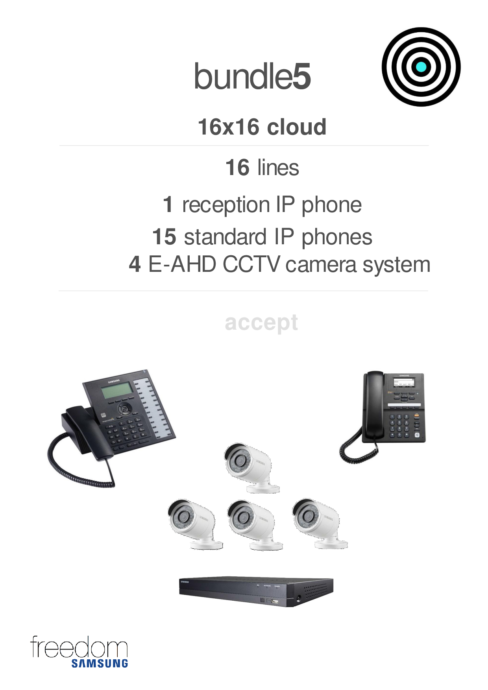
Freedomsamsung Partner

Slide 11
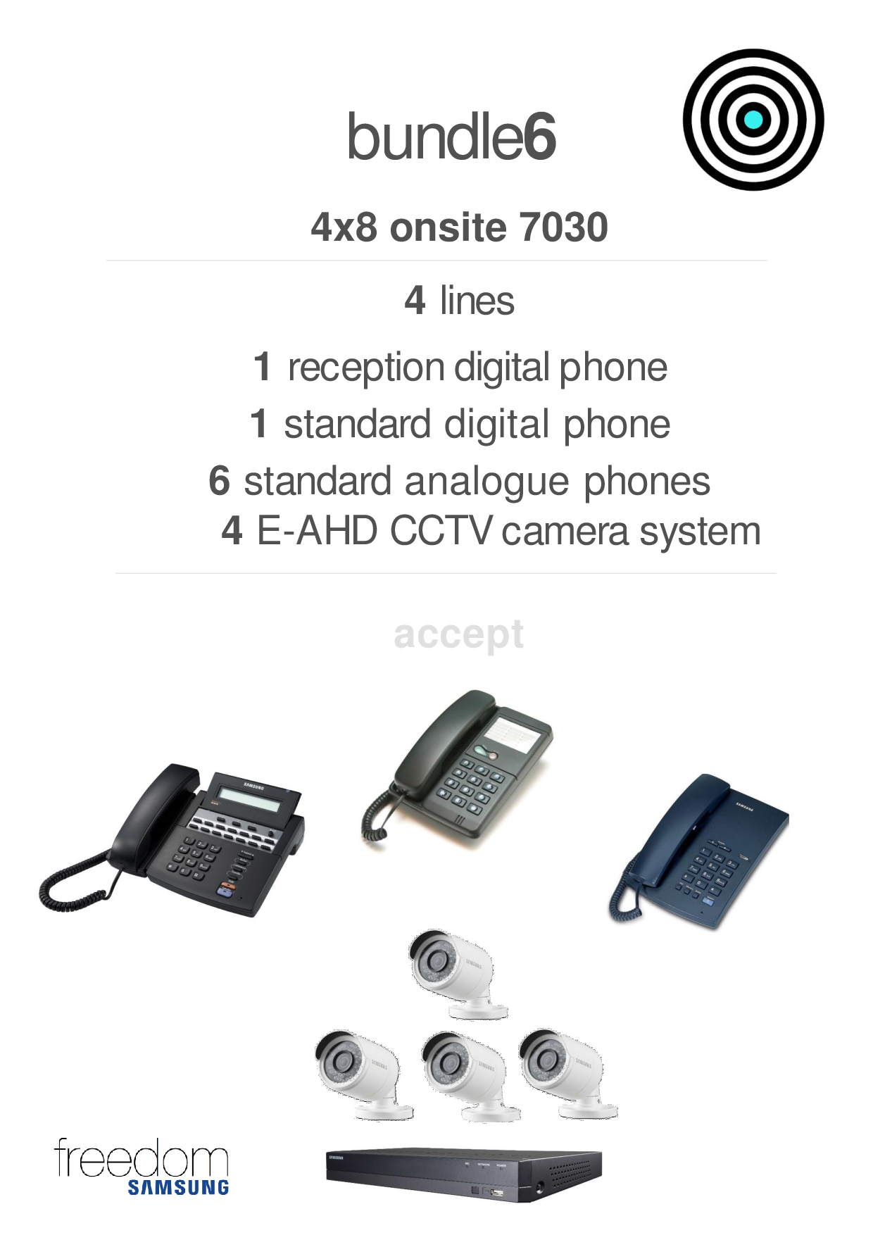
Freedomsamsung Partner

Slide 12
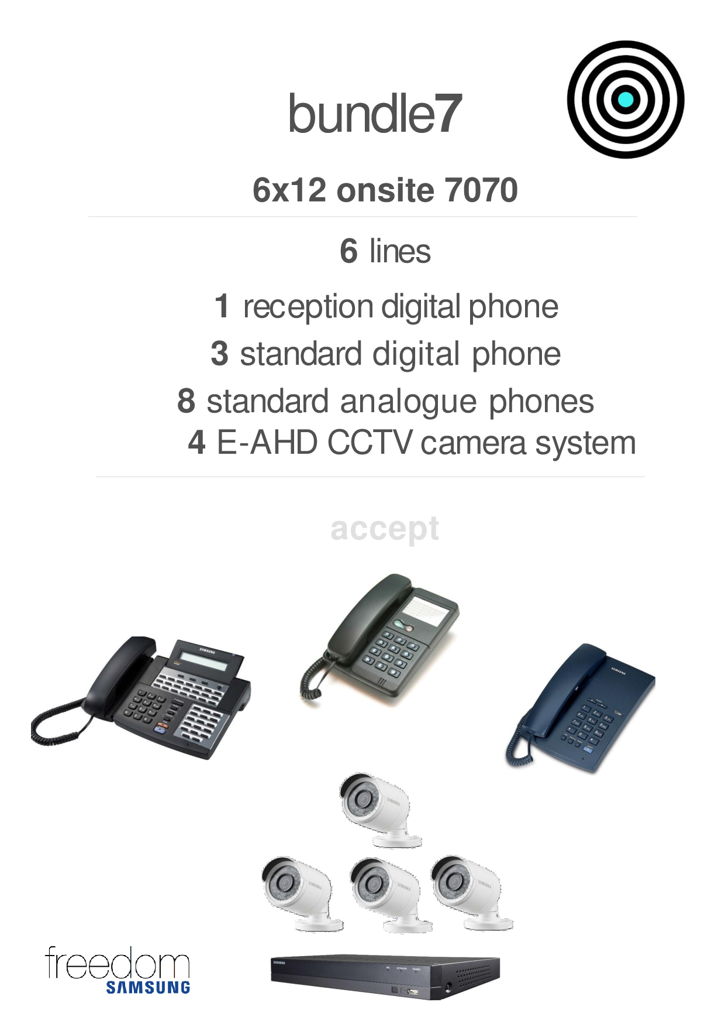
Freedomsamsung Partner

Slide 13
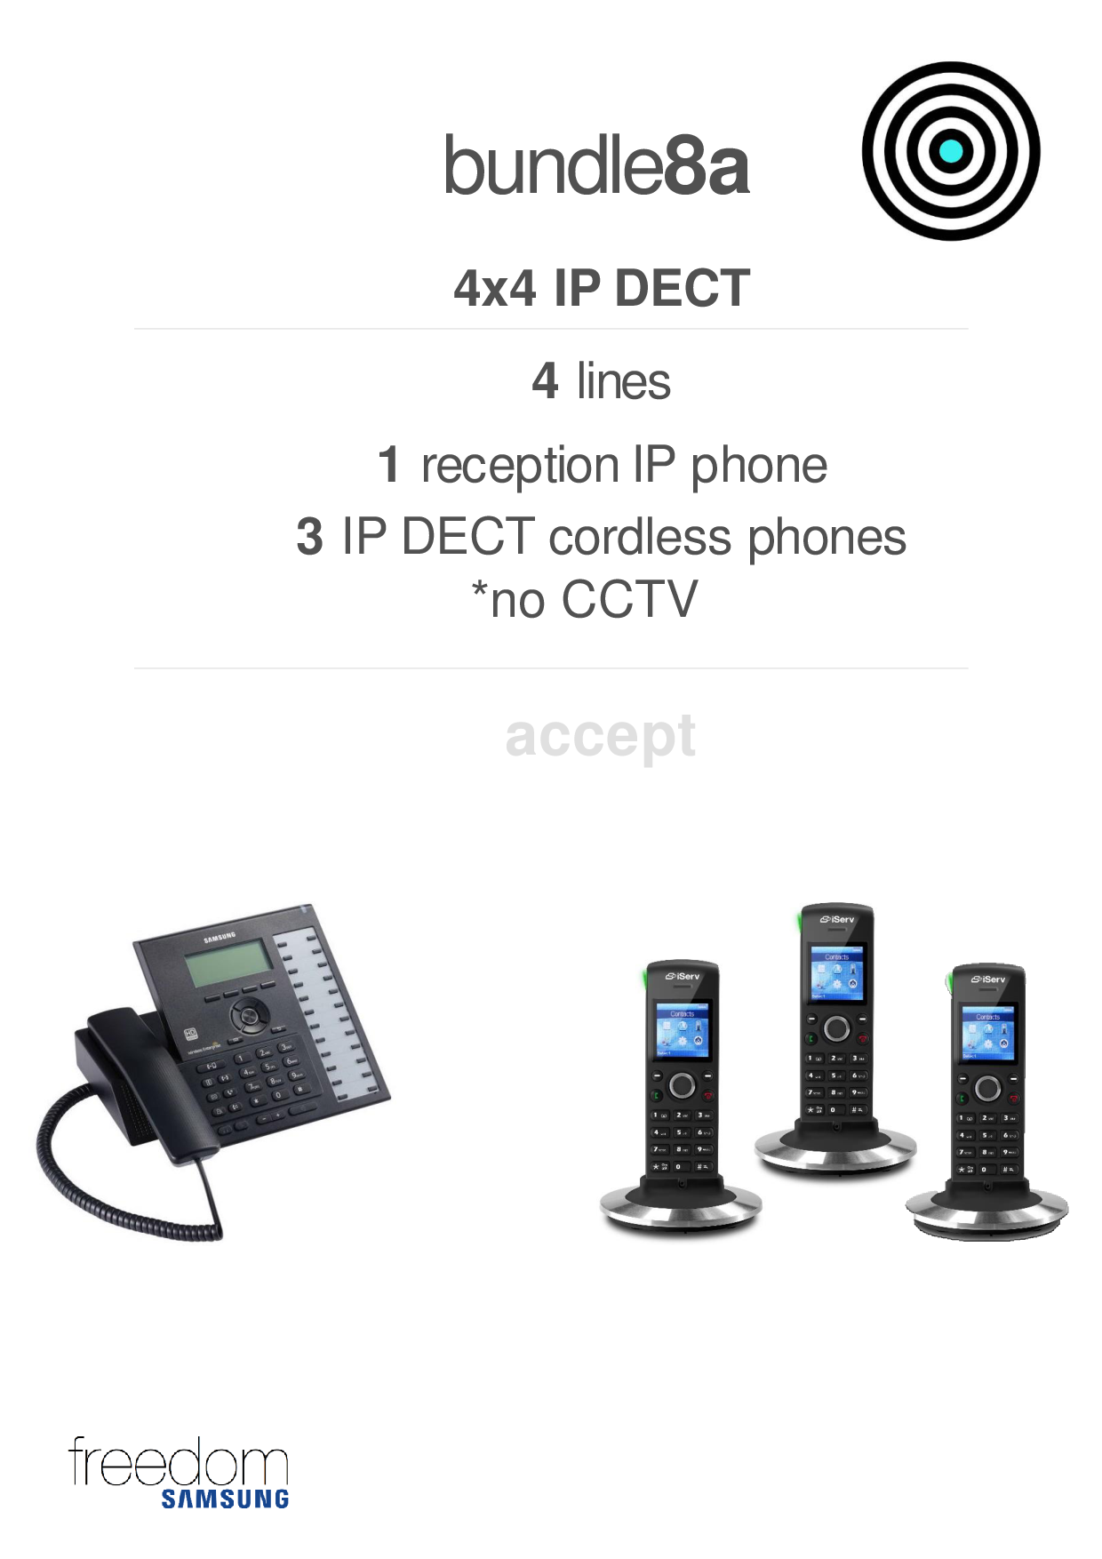
Freedomsamsung Partner

Slide 14
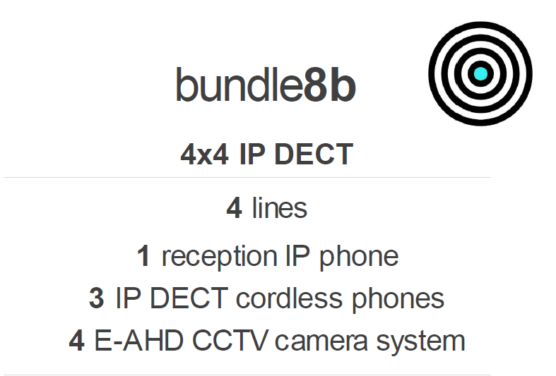
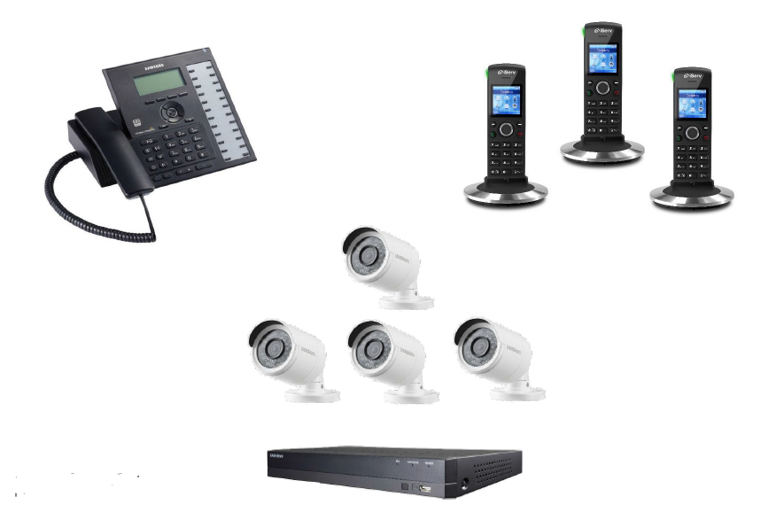
Freedomsamsung Partner

Slide 15
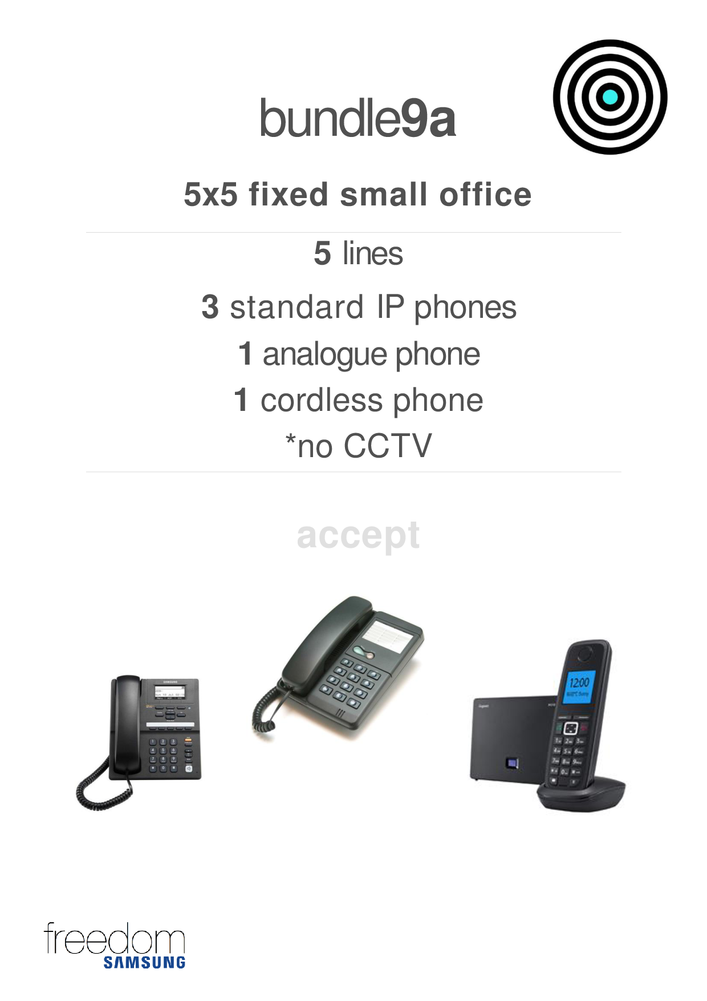
Freedomsamsung Partner

Slide 16
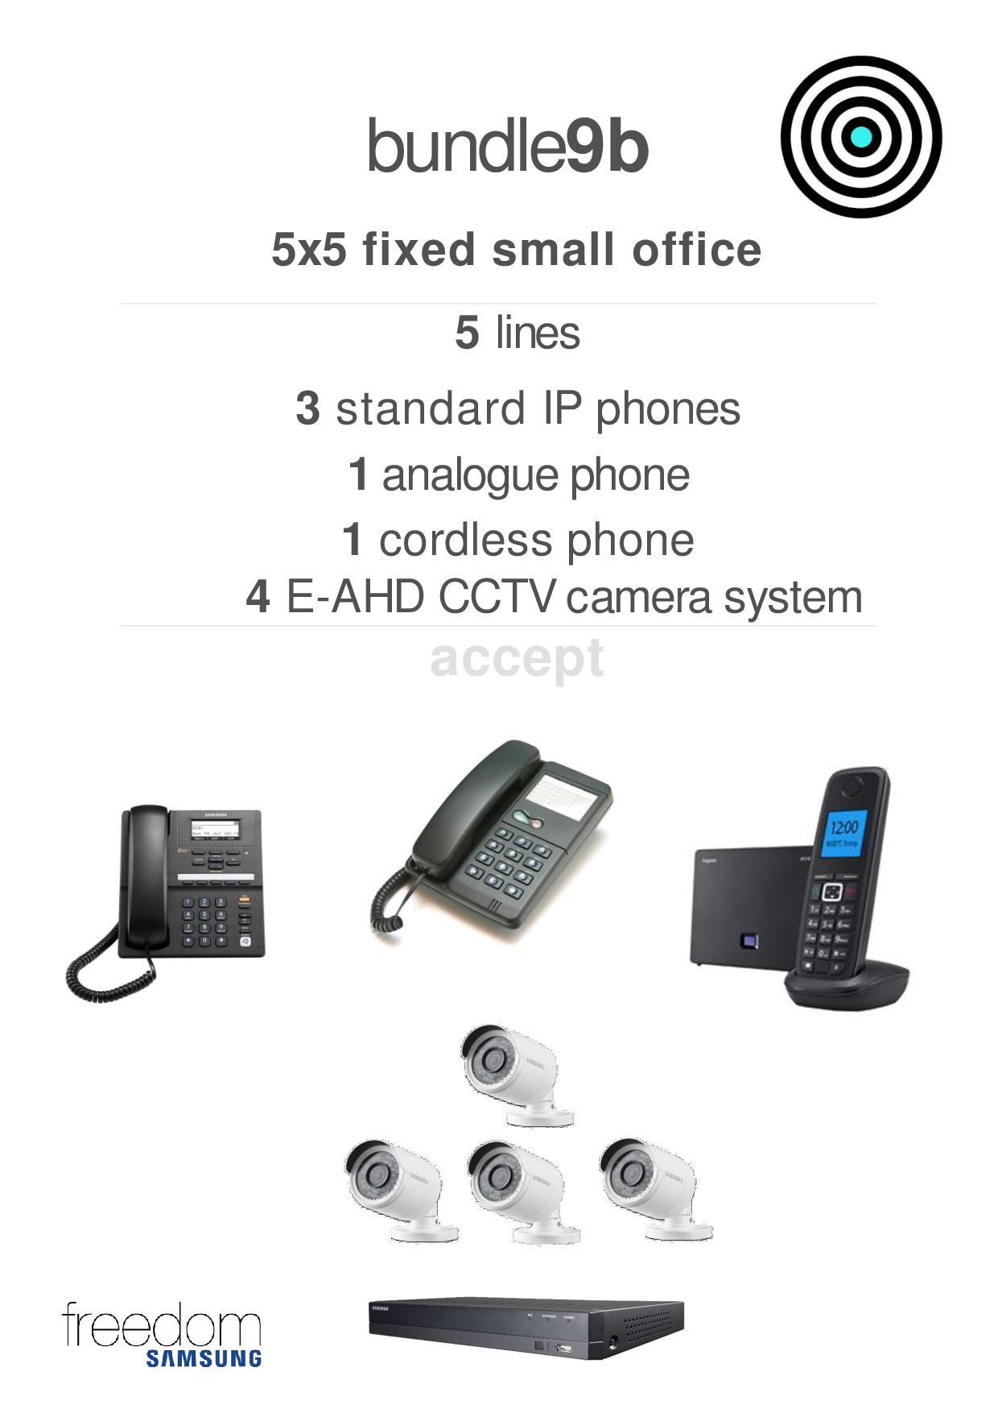
Freedomsamsung Partner

Slide 17
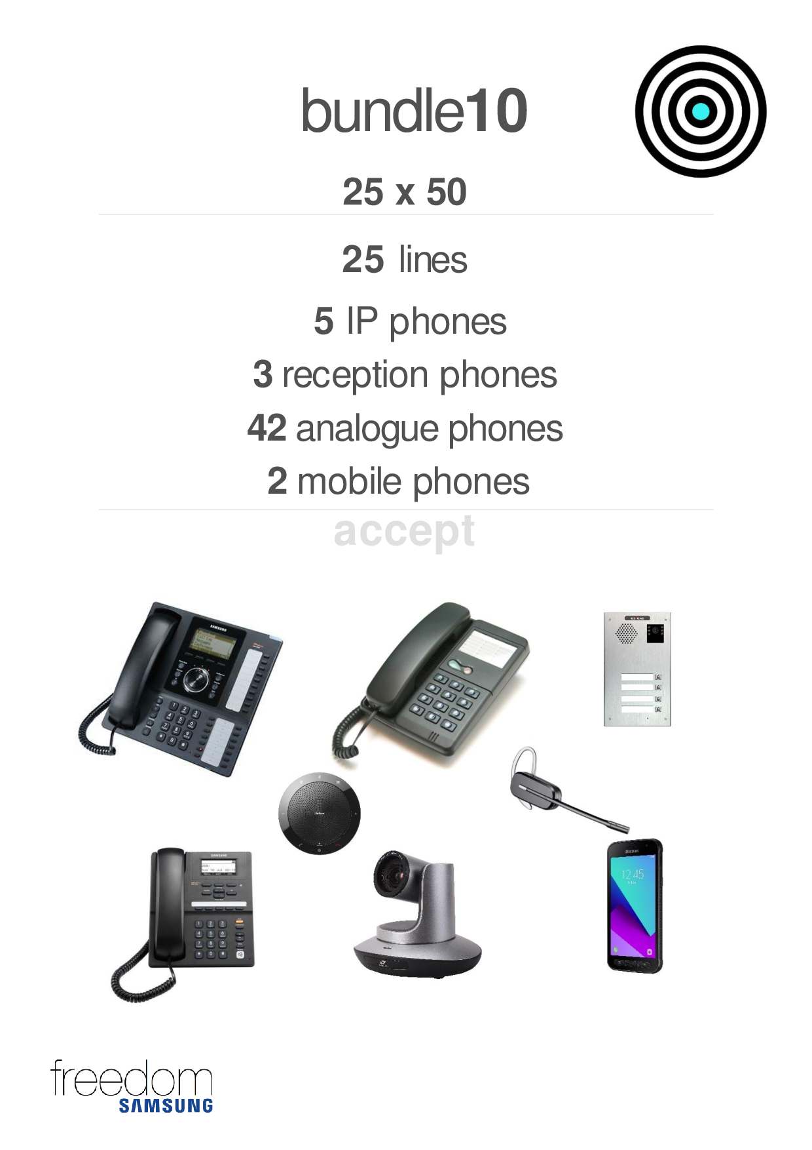
Freedomsamsung Partner

Slide 18
Freedomsamsung Partner

Slide 19
Please contact us for a presentation, we will be there.
Book also for an appointment on our website…..
Contact:
Jerry : 071 313 4287 or 071 445 3330
Ray : 084 984 2117
jeomothale.wixsite.com/lejethomo-pty-ltd
Freedoomsamsung Partner
Freedomsamsung Partner

